Slide 1
FSH Society Family Day SF FSHD Exercise
Richard Gee, PT, Stanford Children’s Health.
15 July, 2017

Slide 2
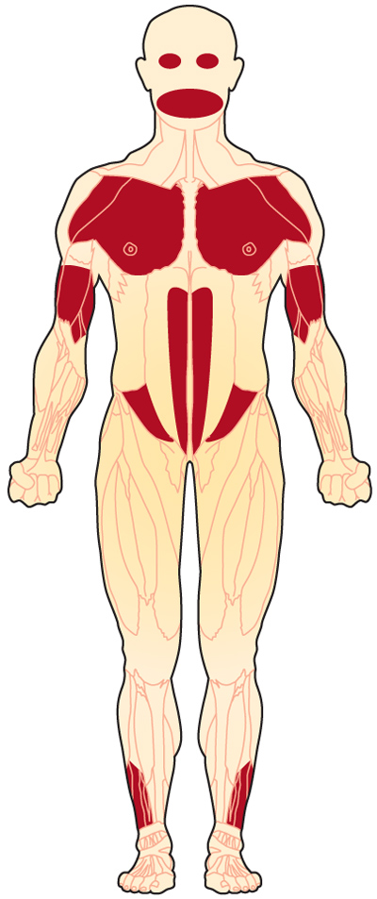
Goals
Review research exercise
Discuss exercise considerations
Discuss Physical therapy
Questions and answers

Slide 3
World Health Organization framework; active aging
Active aging is the process of optimizing opportunities for health, participation and security in order to enhance quality of life as people age. It applies to both individuals and population groups.
The word “active” refers to continuing participation in social, economic, cultural, spiritual and civic affairs, not just the ability to be physically active or to participate in the labor force. …contributors to their families, peers, communities and nations.

Slide 4
Functional Capacity
Kalache 1997

Slide 5
International Classification of Function Disability and Health (ICF)

Slide 6
Muscular Dystrophy: Kevin’s Story
https://www.cdc.gov/features/musculardystrophy/index.html

Slide 7
Research; FACT2 protocol FSHD trial
Aerobic training effect and Cognitive-behavioral therapy effect on chronic fatigue of patients FSHD
57 participants in three groups. Aerobic, CBT, traditional.
16 week intervention, 12 week follow up
Aerobic and CBT groups
lower fatigue level and better physical performance
CBT group
Better sleep quality and social participation.
Aerobic activity
Cognitive-behavioral therapy
are positive; less fatigue.
Voet NG, et al, Neurology 2014

Slide 8
Model of perpetuating factors of experienced fatigue in patients with FSHD.
Positive; improve muscle strength, reduce pain, optimize physical activity and alleviate experienced fatigue.
negative factor; falling and avoidance ; impact on physical activity and social participation
Voet NG, et al, Neurology 2014

Slide 9
Research; cycle ergometer
Aerobic training with patients FSHD 8 patients with FSHD. 12 weeks cycle ergometer, 35 min sessions, for 44 sessions Training increased: Oxygen uptake increased. Maximal workload increased, Improved self report strength, endurance, and level of activity Aerobic activity is likely positive; Low intensity aerobic training improved fitness. David Olsen. Nerology 2005

Slide 10
Research academic report ; cycling and strength training.
Safety and efficacy of a home based exercise program in patients with FSHD
6 months in a training and control group
Cycling 3 times weekly for 35 minute, 24 weeks,
Combined with strength training(not described)
-improved training, improved endurance, 6min walk test.
Combined strength and interval cycling are likely positive and safe
Barkole Am Phys Rehabil Med 2005

Slide 11
How much physical activity do adults need?
2008 Physical Activity Guidelines for Americans
2 hours and 30 minutes (150 minutes) of moderate-intensity aerobic activity(i.e., brisk walking) every week
30 minutes per day for 5 days.
10 minutes at a time is fine
(Same time as watching a movie)
https://www.cdc.gov/physicalactivity/basics/adults/index.htm

Slide 12
How much physical activity do adults need?
2008 Physical Activity Guidelines for Americans
And muscle-strengthening activities on
2 or more days a week work all major muscle groups (legs, hips, back, abdomen, chest, shoulders, and arms).
https://www.cdc.gov/physicalactivity/basics/adults/index.htm

Slide 13
Physical Therapy and FSHD
Physical Therapy for
Facioscapulohumeral Muscular Dystrophy
Kate Eichinger, PhD, Shree Pandya, PT, MS
Windy King, PT
http://www.fshsociety.org/wp-content/uploads/2014/09/FSH-Society-PT-Brochure-Web-Version.pdf

Slide 14
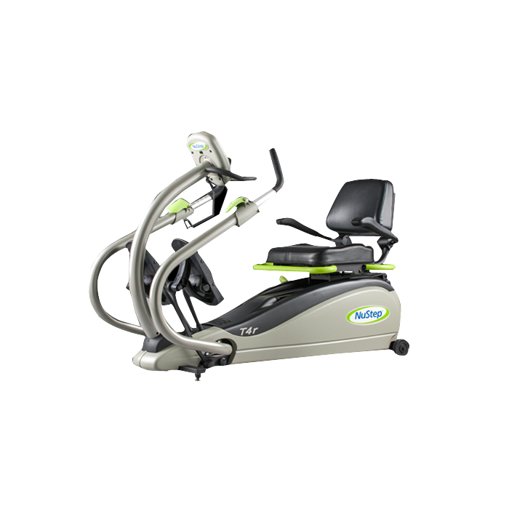
Additional considerations.
Aerobic : cycling, Arm ergometer, Nustep,
Maintain muscle strength.
Note muscle imbalances
Body weight, elastic bands,
Weights; monitor weight, repetition, fatigue
Range of motion in the joints; avoid overstretch

Slide 15
.
Swimming and water exercises for strengthening without causing stress.
Balance
Exercise should not be done to the point of exhaustion
Energy conservation.
Assistive devices, mobility devices, orthotics,

Slide 16
Pain Management
Common sites of pain are lower back, legs, shoulders, and neck.
10.8% of patients have significant pain.
Goal is to improve muscle strength and function.
Minimize injury from falls
Minimize injury from overuse.
Minimize postural dysfunction.
Medical followup Physical therapy referral.

Slide 17
Perceived Exertion Scale
How do we measure Exertion or Intensity

Slide 18
What are your goals?
Monitor
pain fatigue
Maximize Function
Optimize Active participation
Prevent falls
Improve Safety

Slide 19
Questions

Slide 20
Thank you!

